Slide 1
Τι είναι η πατρίδα μου Definition of my country
A project by Theresa Yiakoumatou
Greece
www.netschoolbook.gr

Slide 2
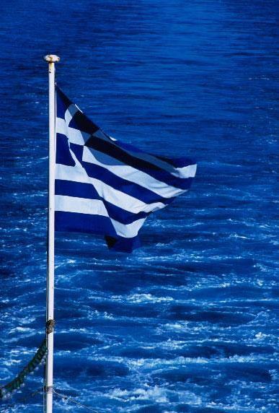
Our flag
The stripes represent the number of the syllables in the phrase: Eleftheria i Thanatos (Liberty or Death).
The striped pattern was chosen because of its similarity with the wavy sea that surrounds the shores of Greece. The interchange of blue and white colors makes the Greek Flag on a windy day to look like the Aegean Pelagos (sea).

Slide 3
Our national anthem
The Greek Anthem is based on the "Hymn to the Freedom", a large - 158 strophes - poem written by Dionysios Solomos, a distinguished poet from Zakynthos Island. The poem was inspired by the Greek Revolution of 1821 against the Ottoman Empire.
Listen to our anthem

Slide 4
First verses of our anthem
Hymn to the Freedom Ι recognize you by the dreadful edge of Your sword. I recognize Your face, forcibly staring at the land. From the sacred graves of the slain Greeks You rise, valiant again. Hail, Oh Hail, Liberty!

Slide 5
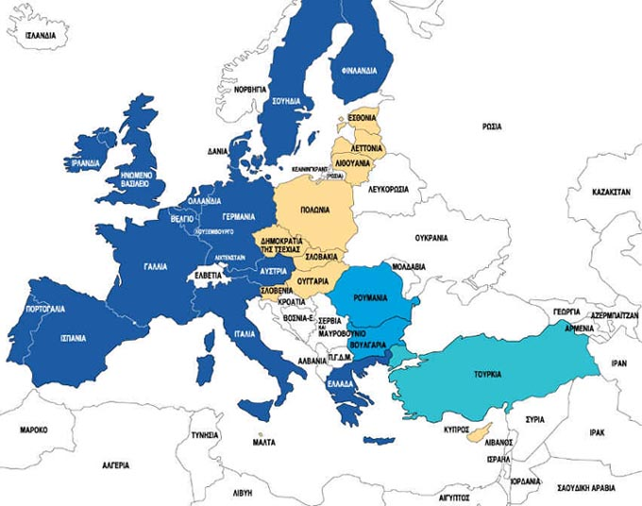
Where are we?

Slide 6
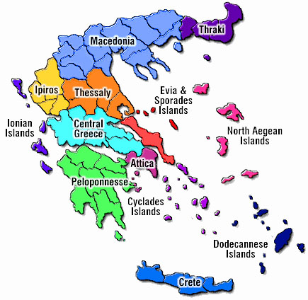
Map of Greece with regions

Slide 7
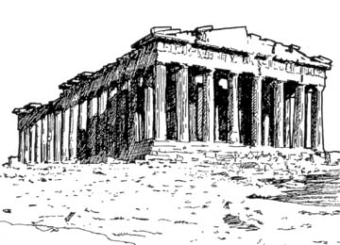
Which is the capital of your country?
The capital of Greece is Athens
We call her Athina
You may know the temple of Athena Parthenon

Slide 8
Which is the population of your country?
Our population is 10,645,343 (July 2002 est.)
4 million live in Athens

Slide 9
THESSALONIKI 40 51 N, 22 96 E, 13 feet (4 meters) above sea level.
The tables below display average monthly climate indicators based on 8 years of historical weather readings
 | Jan | Feb | Mar | Apr | May | Jun | Jul | Aug | Sep | Oct | Nov | Dec
 | 5 | 7 | 9 | 13 | 19 | 24 | 26 | 26 | 21 | 16 | 11 | 6
 | 9 | 11 | 14 | 19 | 25 | 30 | 32 | 32 | 27 | 21 | 15 | 10
 | 2 | 2 | 4 | 8 | 13 | 18 | 20 | 20 | 16 | 11 | 7 | 3
 | 6 | 5 | 5 | 6 | 5 | 2 | 2 | 2 | 3 | 5 | 6 | 5
 | 0 | 0 | 0 | 0 | 0 | 0 | 0 | 0 | 0 | 0 | 0 | 1
 | Avg. Temperature
 | Avg. Max Temperature
 | Avg. Min Temperature
 | Avg. Rain Days
 | Avg. Snow Days

Slide 10
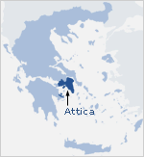
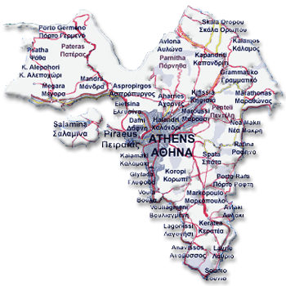
Our school is located…
Our school is located in Athens near the sea in Hellenikon
Hellenikon means Greek

Slide 11
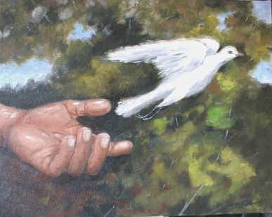
Greece is also called Hellas
HELLAS
H as in Humanism
Greeks were always concerned with human life and the effort to improve humanity through reason

Slide 12
E as we say Equality
HELLAS
Greeks are concerned with the value of every human being on earth and strongly believe that all men should be equal

Slide 13
L as in Light
HELLAS
Greece is very sunny
We Greeks love sun

Slide 14
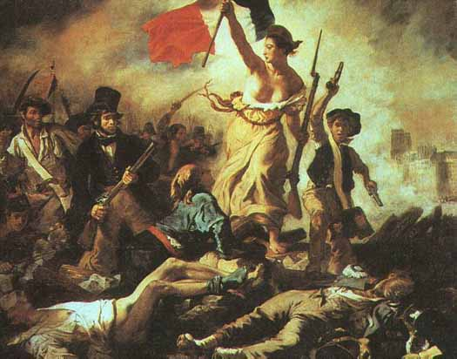
L as in Liberty
HELLAS
Being in the crosswords of Europe and Asia we have fought to defend our liberty

Slide 15
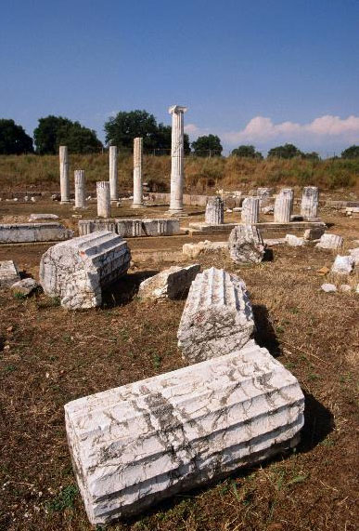
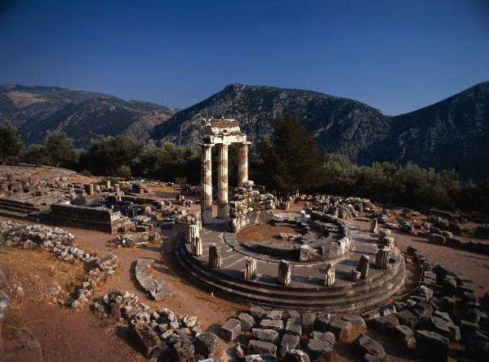
A as in Antiquity
HELLAS
Greece is full of antiquities.

Slide 16
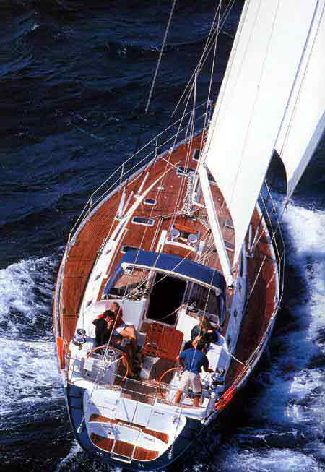
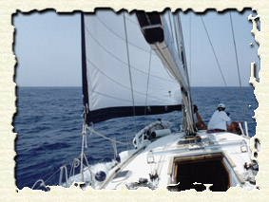
S as in Sea and Sailing
HELLAS
Being surrounded by sea we love it and we also love sailing

Slide 17
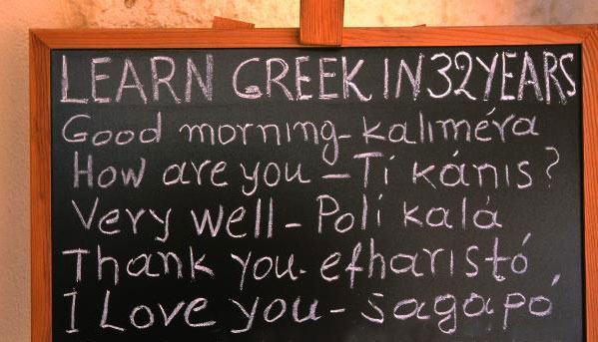
Greetings in your language

Slide 18
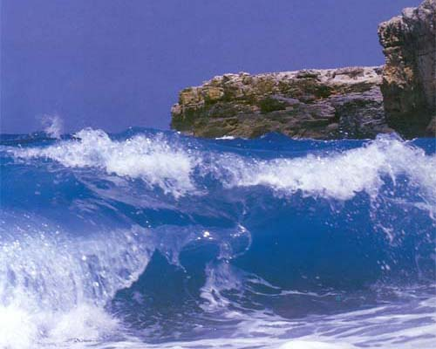
A landscape that you love
"Good God! How much blue colour you wasted so that we won't see you.." Odysseas Elytis
Greece is an endless deep blue colour. It is the archetype of the Mediterranean Sea.
The Blue of the Sea

Slide 19
Write a favourite poem of yours
----"I was given the Hellenic tongue my house a humble one on the sandy shores of Homer. ----My only care my tongue on the sandy shores of Homer. The sea-bream and perch ----windbeaten verbs green currents with the cerulean ----all that I saw blazing in my entrails sponges, medusae ----with the first words of the Sirens pink shells with their first dark tremors." (from Axion Esti, 1959)

Slide 20
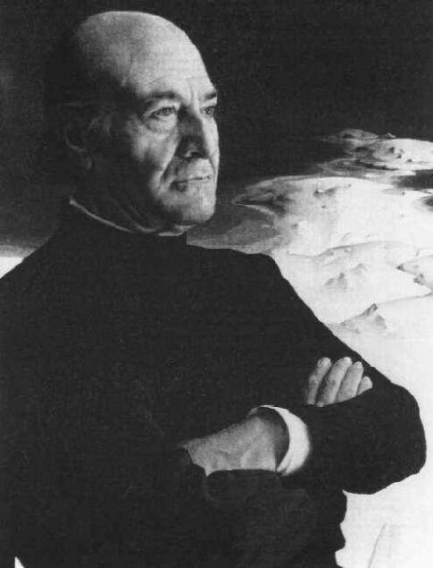
The poet is Odysseas Elytis
The winner of the 1979 Nobel Prize for Literature. Elytis's poems are written in rich language, full of images from history and myths. The lines are long and musical. Inspired by the 'sanctity of the perceiving senses' Elytis celebrated in his early poems the mystery of the Greek light, the sea, and the air. Later themes are grief, suffering, and search for a paradise.

Slide 21
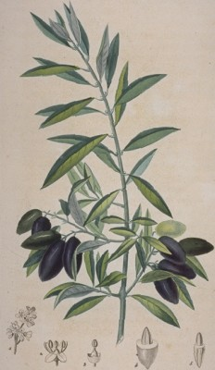
One of our products
Is olive
Greece is full of olive groves. The Olive Tree, is the protagonist of the Greek nature and history as olive oil is the protagonist of the Greek diet.

Slide 22
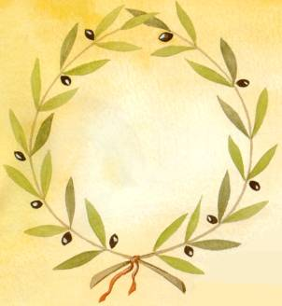
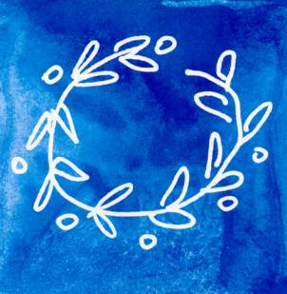
The symbol
For the Ancient Greeks, the olive tree was a symbol of peace, wisdom and triumph. An olive wreath was made, and used to crown the Olympic champions.
Symbol of Olympic games 2004

Slide 23
Write a proverb
Αν δεν σπείρεις, δεν θερίζεις. He that does not sow, does not mow. Il faut semer pour récolter. Säen musst du, willst du ernten. Chi non semina non raccoglie. Quien no siembra, no recoge.

Slide 24
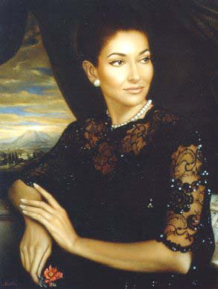
Famous person
Maria Callas was a famous classical singer
Her words "You know, it is a very strange feeling to be a living legend while I am still on the earth. Perhaps it would be better if all those people who admired my voice decided to consider me immortal following my death. If that happened I would sit on some cloud, looking down and I would enjoy the view instead of sitting and worrying about whether I could manage to get out the high notes."

